Slide 1
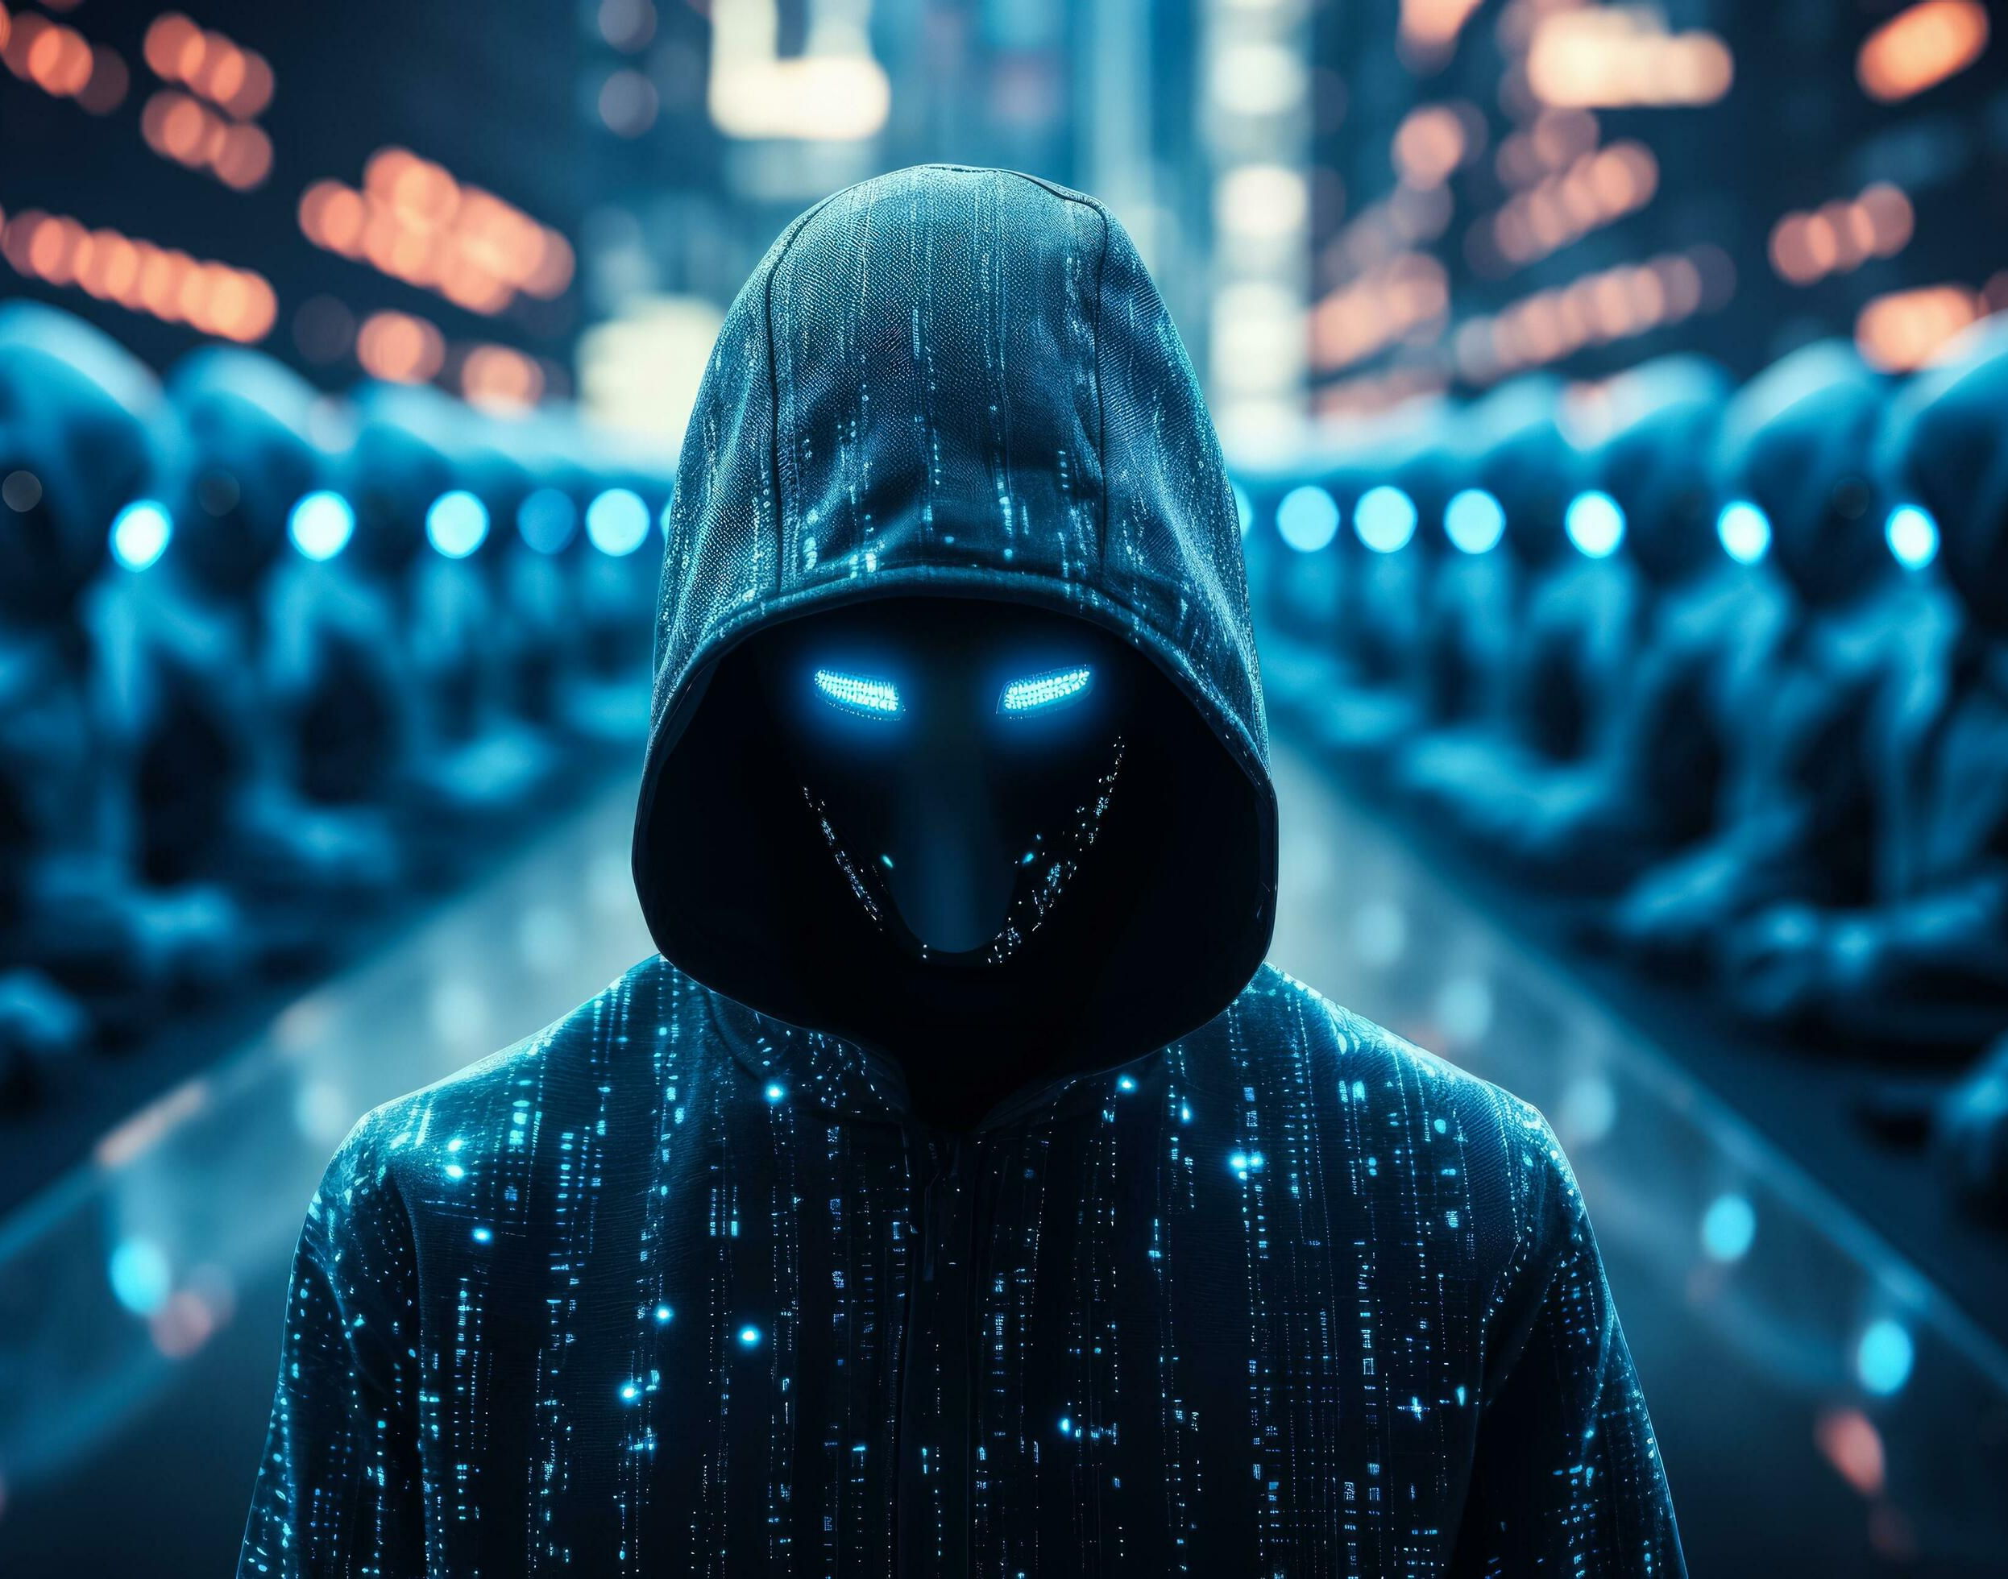
Cyber Security Threat Model
Java Code Checkins -PF
August 2025

Slide 2
Executive Summary
Low
Risk
Cyber Security Threat Model Sensitive

Slide 3
Threat Model Details
Entity Under Review
Name
Java Code Checkins - PF
Description
Authenticated check-in attendees can upload transcript files (WebVTT) to tenant-specific blob storage. The system uses those transcripts to generate AI-based comment suggestions, which the uploader can accept, edit, or discard. Transcripts are removed when the check-in is closed.
Risk Impact
Critical
Scope
This document addresses security considerations for the new “Check-ins Transcript” capability in the People First application. It focuses on how transcript files are uploaded, stored, used to generate AI suggestions, and deleted. T
Key Stakeholders
Wiliam Ferraciolli
Staff Software Engineer
Joe Norley
Product Manager
Sally Young
Senior Software Engineer
Quality Assurance
Security Consultant
David Biayna Neal
01/08/2025
Security Review Meeting
Trefor Walters, Will North
Approved by
Will North
X
Cyber Security Threat Model Sensitive

Slide 4


Threat Model
Azure
3-The authorized attendee selects the check-in and uploads a WebVTT transcript file via the existing Java Attachments API
T01
T02
T03
T04
People First
BLOB Storage
4-The validated transcript is stored in tenant specific blob storage in plaintext (no encryption at rest).
2-The authorized attendee selects the check-in and uploads a WebVTT transcript file via the existing Java Attachments API
API
6- The uploader is presented with a list of AI-generated comment suggestions. The user may delete, amend, or accept these suggestions.
OpenAI
5- The file will be used to generate AI comments based on its content against the check-in it was attached to.
PF User
1.User logs into PF and accesses employee checkin area.
Cyber Security Threat Model Sensitive

Slide 5
Mitigating Controls
Threat Ref. | Threat Description | Control Design | Control Owner | Control Mitigation Effectiveness | Threat Mitigation
T01 | A malicious actor who obtains access to the Blob storage account which contains VTT files in plaintext / unencrypted meeting transcripts. |  | PF | Ineffective | Insufficient Mitigation
T02 | A malicious actor discovers the publicly-facing blob container URL then downloads each VTT file in plaintext. Because blobs are unencrypted and all tenants share the same storage account, the attacker can harvest transcripts not only for one customer but for every tenant’s meeting. |  | PF | Ineffective | Insufficient Mitigation
T03 | A malicious insider who already has legitimate access to the PF service codebase or deployment environment copies the environment’s connection string, then uses it to download every tenant’s unencrypted VTT transcripts directly from the public blob endpoint. |  | PF | Ineffective | Insufficient Mitigation
T04 | A malicious actor manages to steal the VTT transcripts due to the files not being deleted after a period of time. | Once the check-in is closed , the transcript from the Blob Storage, however people may forget to close it within a short period of time. | PF | Ineffective | Insufficient Mitigation
Cyber Security Threat Model Sensitive

Slide 6
Control Weaknesses
Action Ref. | Control Weakness | Threat | Recommendation
A01
Cyber Security Threat Model Sensitive

